Slide 1
2018 “of the Year”
Awards

Slide 2


Wayne Warren
CCM
of the
Year

Slide 3

CCM Young Leader
of the Year
Riley O’Brien, M.E. P.E.

Slide 4
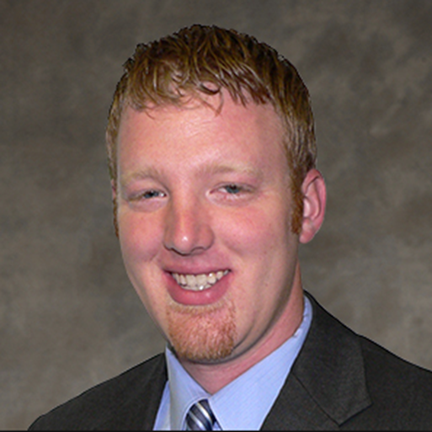

David Schroeder, PM,CCM, LEED, AP
Volunteer
of the
Year

Slide 5

CCM Firm of the Year

Slide 6


CM Firm of the Year

Slide 7

Partner
Association
Award

Slide 8

DBE Firm of the Year

Slide 9


Industry Firm of the Year
by

Slide 10
Client of the Year

