Slide 1
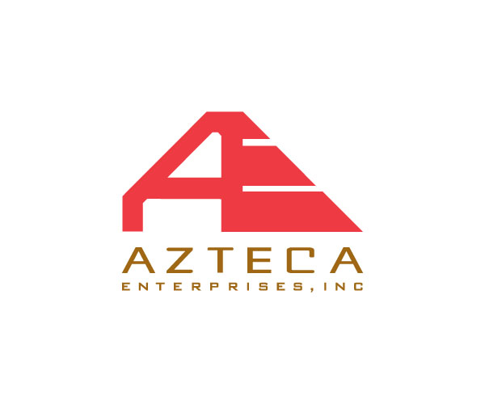
Thank you to our Dinner Sponsors.

Slide 2
Platinum Annual Sponsor
Talk to CMAA Executive Director Sarah Nurse for
information on how your firm can be an Annual Sponsor!

Slide 3
Young Leaders February 8, 2018 Legal Draft Brewery February Dinner Meeting Fort Worth Details will be announced SOON!
UPCOMING EVENTS

Slide 4
Thank you to our Dinner Sponsors.

Slide 5
2017 Capital Bond Program
CMAA North Texas Chapter
January 24, 2018
Rick Galceran
Director, Public Works &
Dallas Bond Program Office

Slide 6
Overview
What has happened so far?
Bond Propositions – what citizens will get
Priorities and Next Steps
Coming Bond Program website
Questions
2017 Capital Bond Program

Slide 7
Events Leading to Today
Community Engagement
City Council Approves Projects
Bond Election
Develop Bond Program Office
Oct 2016 – May 2017
August 9, 2017
November 7, 2017
Nov – Dec. 2017
2017 Capital Bond Program

Slide 8
Public Input Results
Oct 2016 - 31 Public Meetings
Over 1,000 online survey responses received
April to May 2017 - Citizens Bond Task Force
Assisted the City Manager and City Council review and select projects for each proposition
May 22- 23rd 2017 - Citizens Bond Task Force Town Hall Meetings
420 Resident Comment Cards
2017 Capital Bond Program

Slide 9
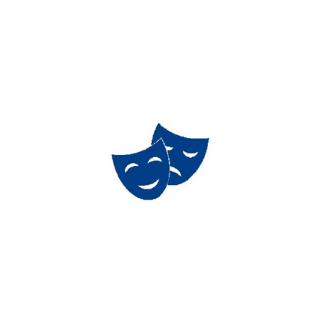
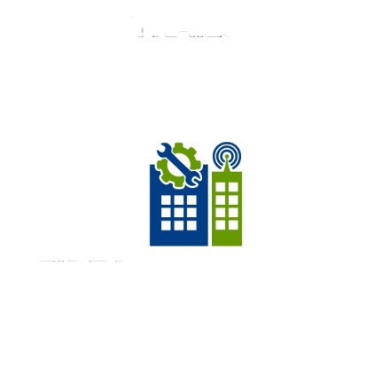
2017-2022 Bond Program
$1.050 Billion - 1,322 Projects
Prop A
Streets
Prop B
Parks
Prop C
Fair Park
Prop D
Flood
Prop E
Libraries
$533.981M
$261.807M
$50M
$48.75M
$15.589M
1027 Projects
163 Projects
12 Projects
85 Projects
3 Projects
Prop I
Economic
Development
Prop J
Homeless
Facilities
Prop F
Cultural Arts
Prop G
Public Safety
Prop H
City Facilities
$14.235M
$32.081M
$18.157M
$55.4M
$20.0M
9 Projects
16 Projects
7 Projects
2017 Capital Bond Program

Slide 10
Proposition A: Streets and Transportation
1027 Projects - $533,981,000:
Projects to construct or improve streets sidewalks, and multimodal facilities in coordination with established transportation plans and other agencies.
Traffic Signal System Upgrades
Installation of warranted traffic signals at 68 locations citywide
Street Reconstruction
Street Resurfacing
Sidewalk Replacement
Critical Bridge Repair
2017 Capital Bond Program

Slide 11
Proposition B: Parks and Recreation
163 Projects - $261,807,000
Projects that will acquire, develop or renovate parks and park facilities amenities. Key projects for the parks proposition include:
Aquatics Master Plan Phase 1 and 2
Southern Gateway Public Green
Dallas Zoo, Dallas Arboretum and Klyde Warren Park Expansions
X miles of trail improvements
Rehabilitation and Expansion of multiple recreation centers
2017 Capital Bond Program

Slide 12
Fair Park
14 Project - $50,000,000
Projects will rehabilitate 14 historical facilities. Rehabilitation will include roof repairs, water infiltration, HVAC replacements, plumbing improvements, upgrading security and telecom systems, and face repair.
Hall of State
African American Museum
Coliseum
Texas Discovery Gardens
Food and Fiber Building
Magnolia Lounge
Tower and Centennial Buildings
Science Place
Aquarium Annex
Pan American Complex
2017 Capital Bond Program

Slide 13
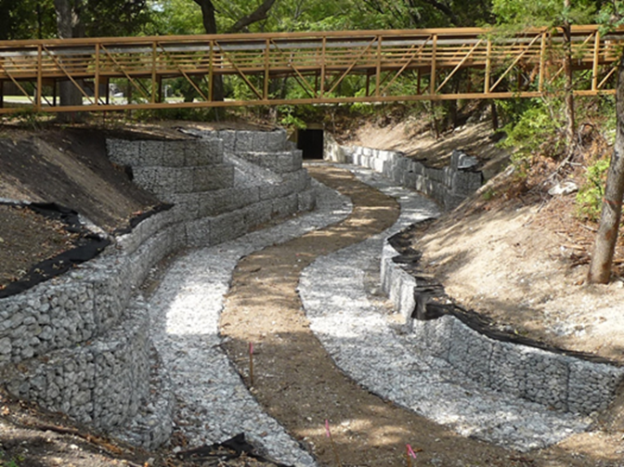
Flood Control and Storm Drainage
85 projects - $48,750,000
Projects to improve or develop storm water drainage systems, erosion control, and flood management to minimize repetitive flood loss.
Storm Drainage upgrades
Erosion Control Embankments
Flood Control Measures
Vinemont Channel Improvement Project
2017 Capital Bond Program

Slide 14
Library Facilities
3 projects - $15,589,000
Three critical projects to improve the City’s library system.
Replace existing Forest Green Branch Library with a 9,000 sq. ft. facility
Construct a new library in the Vickery Meadow/Midtown are
Plumbing and roofing improvements at the J. Erik Jonsson Central Library
2017 Capital Bond Program

Slide 15
Cultural and Performing Arts Faciliites
9 projects - $14,235,000
Rehabilitation of nine cultural and performing arts facilities. Projects include waterproofing, water infiltration, roof replacements, security upgrades, and electrical and plumbing improvements. Replacement of reverberation door control system at the Morton H. Meyerson Symphony Center
Dallas Museum of Art
Bathhouse Cultural Center
Kalita Humphrey’s Theatre
Dallas Black Dance Theatre
Sammons Center
South Dallas Cultural Center
2017 Capital Bond Program

Slide 16
Public Safety Facilities
16 projects - $32,801,000
Construct and design new public safety facilities. Rehabilitate existing facilities, and security upgrades at the Jack Evans Police Headquarters and 7 Police Substations.
New Fire Station at Loop 12 and Jim Miller
Replace Fire Stations 36 and 46
Interior renovations (kitchens, showers and living quarters) at 15 Fire Stations
Waterproofing, HVAC replacement, electrical, mechanical and plumbing improvements at 12 Fire Stations
2017 Capital Bond Program

Slide 17
City Facilities
7 projects - $18,157,000
Projects to expand and rehabilitate existing City Facilities:
New 2,000 sq ft. storage facility
8,000 sq. ft. expansion of West Dallas Multipurpose Center
City Hall Renovations (roof replacement, restroom upgrades to meet ADA compliance, water infiltration and replacement of electrical panels
Replacement of electrical panels at 37 facilities
Renovations to 9 City Facilities
Phase 1 Renovation of the Oak Cliff Municipal Center
2017 Capital Bond Program

Slide 18
Economic Development and Housing
$55,400,000
Funding to help facilitate economic development and housing opportunities throughout the City
Revitalization of Commercial Corridors
Transit Oriented Development
Mixed Income Housing
Mixed-Use Development
Neighborhood Revitalization
2017 Capital Bond Program

Slide 19
Homeless Assistance Facilities
$20,000,000
Funding for Permanent Supportive and Transitional Housing
Permanent supportive housing targeting:
Chronic homeless
0-30% area median income (AMI)
Rapid rehousing addressing:
Elderly and disabled
Families with children
Young adults (ages 18-24)
Day centers for seamless wrap-around services
2017 Capital Bond Program

Slide 20
Bond Program Highlights
No Property Tax Rate Increase
Focus on Reconstruction and Rehabilitation
51% Streets and Transportation Projects
Over 500 Lane Miles
$500 Million Leveraged Outside Funding
2017 Capital Bond Program

Slide 21
2017 Bond Program Delivery
Shovel ready projects
Projects currently under design
On-call contract delivery
Funding Agreements
Design Build projects
Mass Selection of Design Consultants
2017 Capital Bond Program

Slide 22
Next Steps
Program Manager
February
April
Negotiation
May
Award/Begin activities
March
Selection
June
Design Consultant
February
April
Selection
May
Negotiation
March
Advertisement
June
Award/Begin activities
Shovel-Ready Projects
February
Advertisement
April
May
Award
March
June
Begin construction
2017 Capital Bond Program

Slide 23
Bond Program Website
New “dashboard” website will go live in late January 2018
Website will allow users to:
Track the status of projects, propositions and the Bond Program as a whole
Learn specifics of any project, e.g. funding, participating agencies, location and delivery department
Search for projects using an interactive GIS map
Data will be updated automatically in real time through project management database
2017 Capital Bond Program
Notes:
TRIRIGA

Slide 24
Thank You
Questions/Answers
24
2017 Capital Bond Program

Slide 25
2017 Capital Bond Program
CMAA North Texas Chapter
January 24, 2018
Rick Galceran
Director, Public Works &
Dallas Bond Program Office

